Slide 1
Exploratory Data Analysis - Used Cars
EDA on used car dataset from cars24
"https://www.cars24.com/buy-used-cars-hyderabad/?itm_source=Cars24Website&itm_medium=seconda

Slide 2
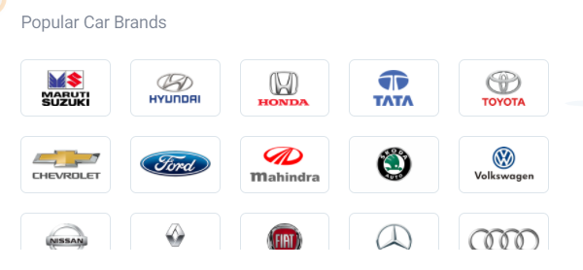
Introduction
Web Scraping EDA on used car dataset from cars24
"https://www.cars24.com/buy-used-cars-hyderabad/?itm_source=Cars24Website&itm_medium=seconda
CARS24 is a next generation ecommerce platform for preowned autos (cars and bikes).
Web Scraping in Python offers an introduction to the techniques of data extraction from the web.

Slide 3
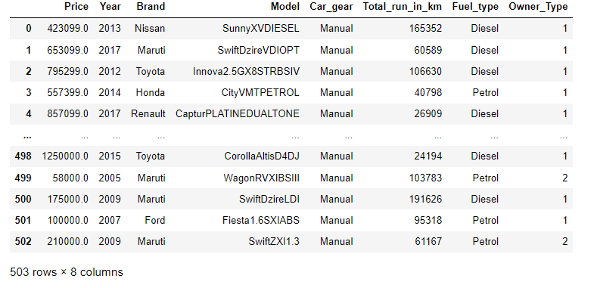
Exploratory Data Analysis - Used Cars

Slide 4
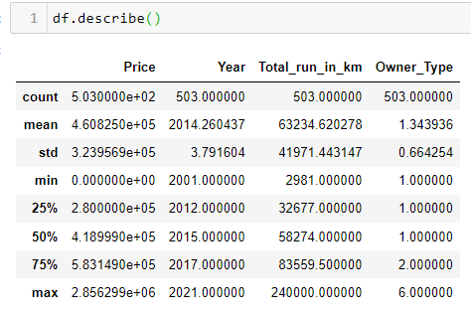
Data Description
To get some quick description out of the data

Slide 5
EDA on used car dataset from cars24
Exploratory Analysis : It’s a data exploration technique to understand various aspects of data. Data Analysis is performed using following methods
Univariate Analysis:
Uni means one and variate means variable, so in univariate analysis, it is the simplest form of analysis where single variable is analyzed.
Bivariate Analysis: Bi means two and variate means variable, where two variables are analyzed to determine the relationship between each other.
Multivariate Analysis: Multivariate analysis (MVA) techniques allow more than two variables to be analyzed at once

Slide 6
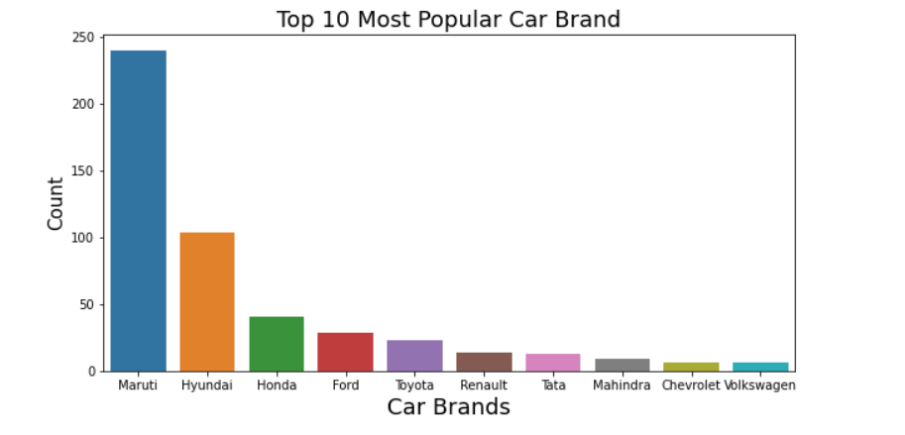
Top 10 most popular car brand?
From the above count plot, top 10 Most Popular Car Brand are Maruti and Hyundai with the count value of 240 and 104 respectively.
We see that Chevrolet and Volkswagen has the least value count of 6 each.

Slide 7
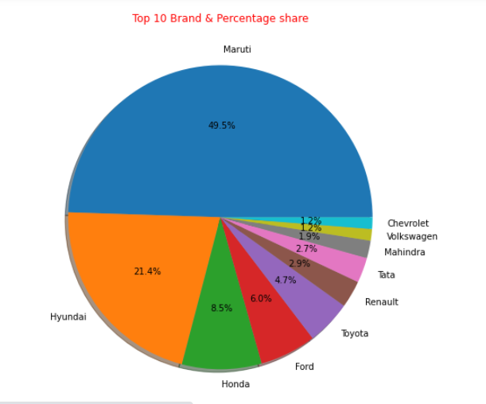
From the above pie chart, top 10 Most Popular Car Brand and its percentage share are
Maruti covers over 49.5% of share followed by Hyundai with the share value of 21.4%
We see that Chevrolet with 1.2% only

Slide 8
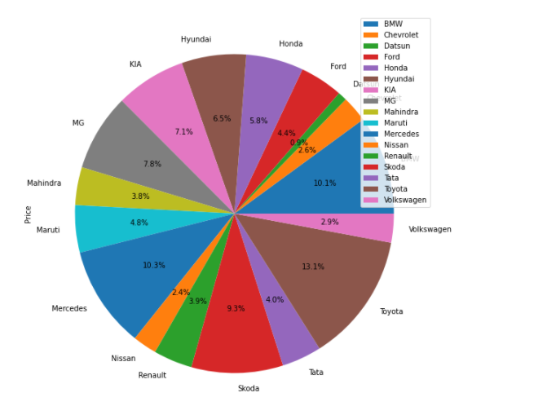
From the pie chart, we see the highest car price brand is Toyota with the max share of 13.1% which is RS. 2856299

Slide 9
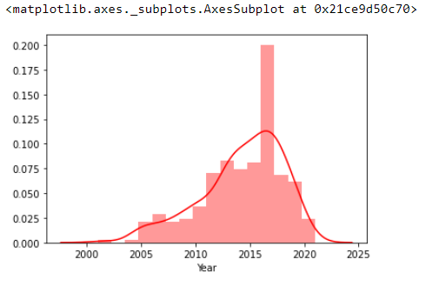
Univariate Distribution
From the above diagram, we see that year 2013 to 2020 marked as high sales of used cars, we can say that the sale of used cars are high in the year 2017

Slide 10
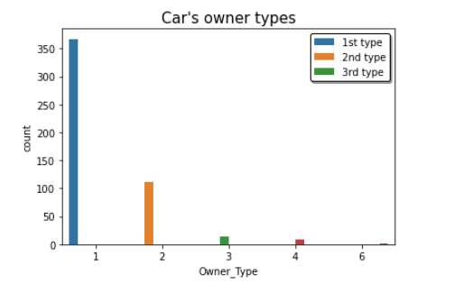
From the above plot we can see most of the cars belongs to 1st Owner type which counts 367 followed by 2nd, 112

Slide 11
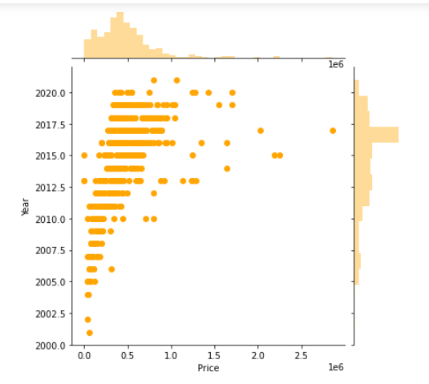
Scatter Plot

Slide 12
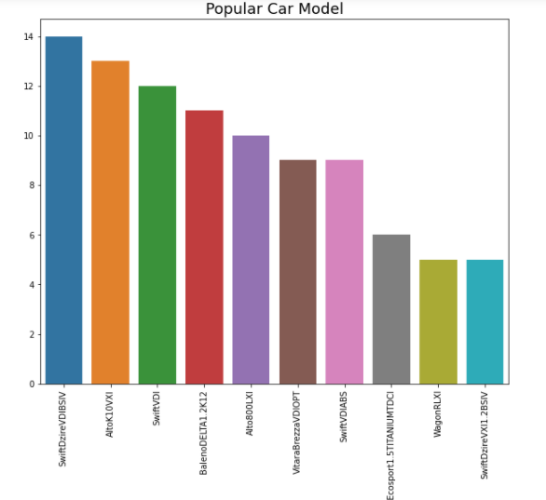
What car model is most popular
Maruti, SwiftDzireVDIBSIV is the most popular model among cars with the count value of 14 Although there are significant number of other model cars too.

Slide 13
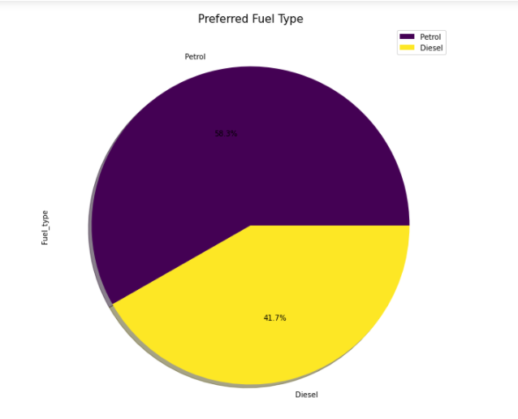
Which Fuel type is preferred the most?
From the above pie chart, Petrol is the most preferred Fuel type, followed by Diesel. Car Fuel are mostly built for petrol and diesel as they are widely abundant

Slide 14
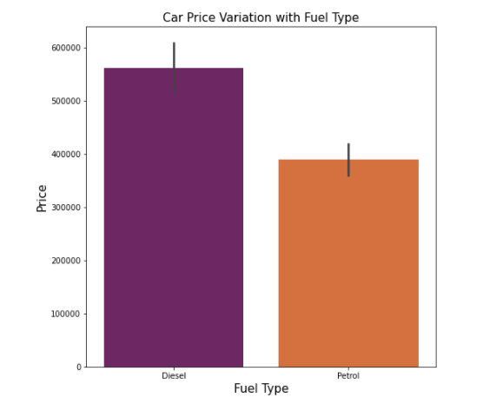
Car Price Variation with Fuel Type,
From the above bar plot, when analyzed for car fuel type based on price, we can observe that Diesel type is most expensive.

Slide 15
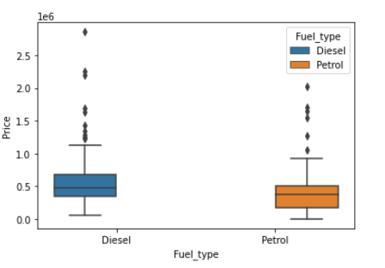
Boxplots

Slide 16
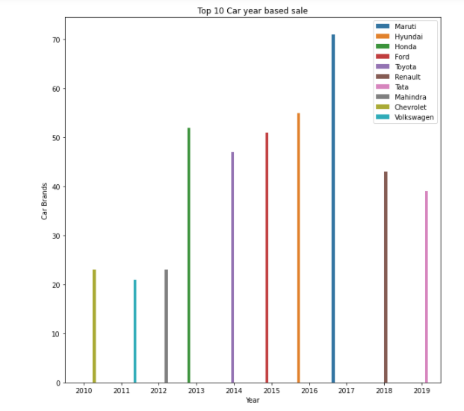
Top 10 Car year-based sale
From the above bar plot, as we can see, 2017 year has a high number of cars for sale

Slide 17
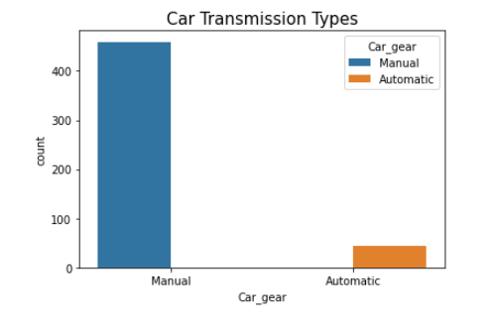
From the count plot, we can see Manual type cars is the most available gear type which counts 459

Slide 18
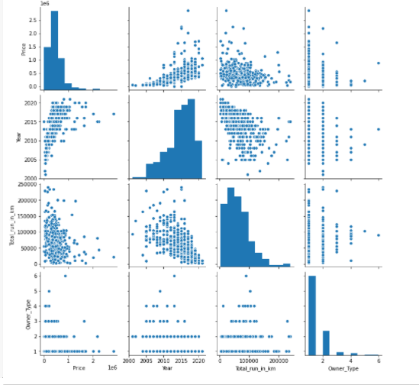
Visualizing pairwise relationships in a dataset

Slide 19
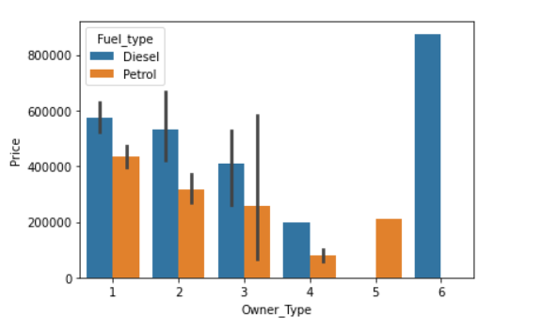
From the above bar plot, we can observe that most of the cars with high price are having fuel type as Diesel and are belongs to 1st owner type.

Slide 20
Conclusion
From the dataset, top 10 Most Popular Car Brand are Maruti and Hyundai with the count value of 240 and 104, respectively .
From the above pie chart, top 10 Most Popular Car Brand and its percentage share are Maruti covers over 49.5% of share followed by Hyundai with the share value of 21.4%
We see that the highest car price brand is Toyota with the max share of 13.1% which is RS. 2856299
Most of the cars belongs to 1st Owner type which counts 367 followed by 2nd, 112
SwiftDzireVDIBSIV is the most popular model among cars with the count value of 14 Although there are significant number of other model cars too
Petrol is the most preferred Fuel type, followed by Diesel. Car Fuel are mostly built for petrol and diesel as they are widely abundant.
When analyzed for car fuel type based on price, we can observe that Diesel type is most expensive
2017 year has a high number of cars for sale
Manual type cars is the most available gear type which counts 459

Slide 21

THANK YOU

